Slide 1


Design Of Electric Vehicle-Battery pack
Review-I
AY 2025-26
Capstone Project – Introduction (PROJ2999)
GITAM (Deemed-to-be) University
Department of Electrical Electronics and Communication Engineering
Project Team:
B.SAI KALYAN(BU22EECE0200026)
K.KEERTHI(BU22EECE0200010)
Project Mentor:
Mr K.Lokeshwara rao
Project In-charge:
Dr.Kshitiji Shakya
www.gitam.edu

Slide 2
Objective and Goals
Objective
To design and analyze a Lithium-ion battery pack for an electric vehicle that ensures optimal performance, safety, and efficiency while meeting the required energy and power demands.
Goals
Main Goals
1.Select suitable Lithium-ion cell chemistry (e.g., NMC, LFP).
2. Design series-parallel configuration for desired voltage (e.g., 60V, 72V, etc.).
3. Calculate energy capacity (kWh) and expected driving range.
4. Integrate Battery Management System (BMS) for monitoring and protection.
5. Ensure thermal safety and efficient cooling design.
Additional Goals
Cost estimation.
Estimate driving range achievable with the designed pack.
Compare with commercial EV battery packs in terms of cost and efficiency.
Environmental impact.

Slide 3
23 days
16 days
15 days
45 days
30 days
6 days
3 days
3 days
3 days
3 days
7 days
6 days
2025
2026
Project Plan
PROJECT
PLAN
Aug 11
Aug 18
ABSTRACT
Aug 19
Aug 20
LITERATURE
Aug 21
Sep 17
EXPLORING SUITABLE BATTERIES
Sep 18
Sep 20
DOCUMENTATION FOR REVIEW 1
Sep 21
Sep 24
DESIGNING OF BATTERY PACK
Sep 25
Oct 16
TESTING OF BATTERY PACK
Oct 15
Nov 4
DOCUMENTATION FOR REVIEW 2
Nov 4
Nov 6
ADDING BATTERY PACK TO EV
Nov 10
Nov 21
FINE TUNNING THE EV BIKE WITH BATTERY PACK
Nov 24
Dec 15
FINAL PRESENTATION
Dec 22
Dec 31
WRITING A PAPER
Dec 24
Dec 31
Aug
Sep
Oct
Nov
Nov
Nov
Dec
Today

Slide 4
Literature Survey
1.A review of improvements on electric vehicle battery” — A. K. Koech et al., 2024
Comprehensive review of materials, thermal management, and pack-level improvements for EV batteries.
2.“Automotive battery pack standards and design characteristics” — S. Haghbin et al., 2025 (Springer)
Survey of mechanical, electrical, safety, and diagnostic requirements for modern automotive battery packs.
3.“A critical review of battery cell balancing techniques” — N. Khan et al., 2024
Detailed review of passive and active balancing methods and their impact on pack life & safety (useful for BMS design).
4.“A review of improvements on electric vehicle battery” / electrothermal comparisons (MDPI) — M. Assi et al., 2025
Electrothermal modeling comparing LFP vs NMC (directly relevant to your chemistry choice and pack thermal design).
5.“Life cycle assessment of battery electric vehicles” — M. S. Koroma et al., 2022 (PMC/MDPI)
LCA covering battery production, use, and recycling — good for the “environmental impact” slide.
6.“Cell teardown and characterization of an automotive prismatic cell” — S. Stock et al., 2023
Hands-on teardown and characterization of cells from a production EV — great for “existing implementations / lessons learned”.
7.“Battery Management System for Electric Vehicles” — A. Kurkin et al., 2025 (MDPI)
Recent survey focused on BMS architectures, SoC/SoH estimation, and monitoring algorithms.
Key Publications

Slide 5
Key Resources – Whitepaper| Application Notes | Datasheet| Others
Existing Implementations – Products| Opensource| GitHub etc
1.BYD Blade battery analyses / feasibility papers — academic and industry analyses explaining BYD blade mechanical layout and safety testing (great for comparing LFP prismatic pack architecture)
2. Mechanical design of battery packs (research projects) — project reports and conference papers focusing on mechanical packaging, busbar routing, and cooling for automotive battery packs.
3. Tesla 4680 / structural pack teardowns and analyses — several teardown analyses & academic studies examine the 4680’s thermal/current collection challenges (good for learning tradeoffs when using large format cells).
`
CATL — Technology & product pages (CTP/CTC, Qilin families)
CATL pages explain modern “cell-to-pack” (CTP) and high-voltage designs and Qilin pack concept — useful for structural pack & energy density comparisons.
BYD — Blade Battery technology overview
BYD’s Blade Battery technical pages describe prismatic LFP configuration, safety advantages, and packaging approach (good LFP counterpoint to NMC/Li-ion).

Slide 6
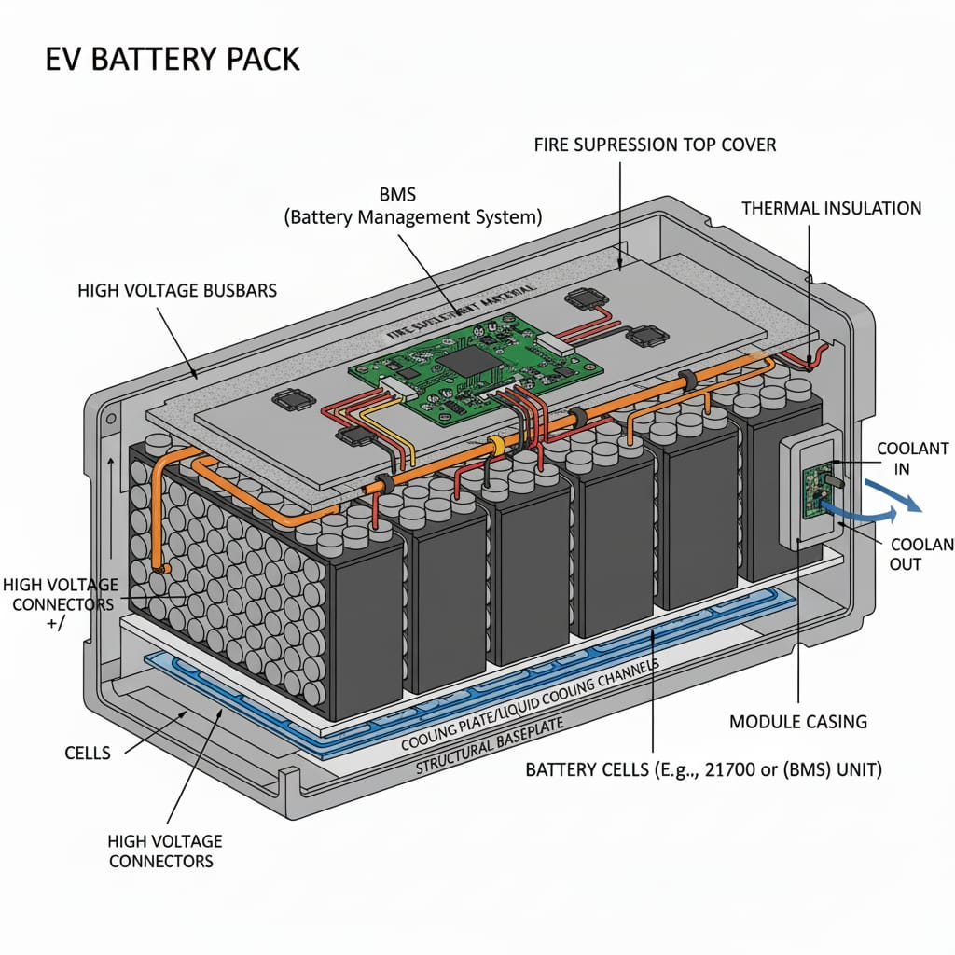
Architecture
EV BATTERY PACK
STRUCTURAL DIAGRAM

Slide 7
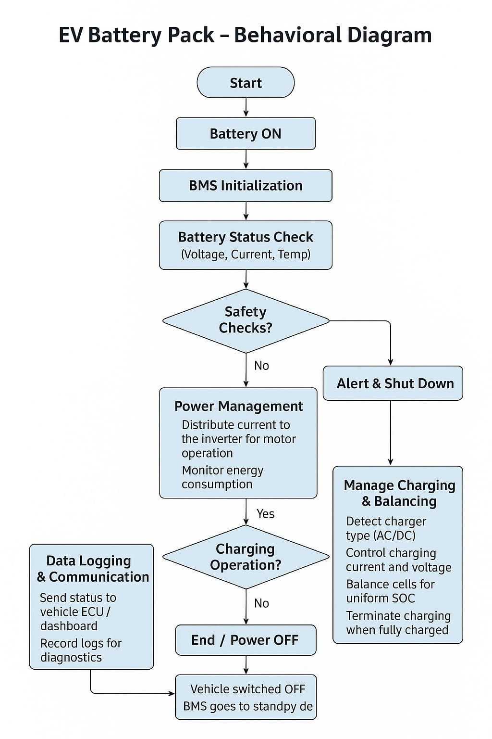
ELECTRIC VEHICLE BATTERY PACK
BEHAVIOUR DIAGRAM

Slide 8
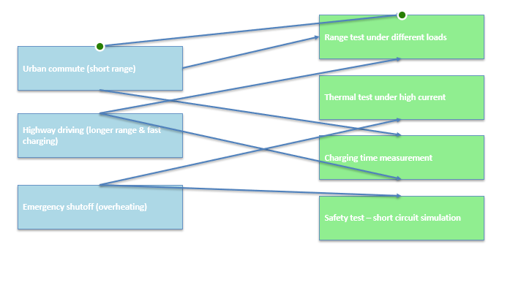
Use Cases & Testing
Use Cases
1.Urban commute (short range): Battery powers vehicle for ~5–10 km daily city travel; moderate discharge rates.
2.Highway driving (longer range & fast charging): Pack supports higher continuous power output and accepts higher charging current for reduced downtime.
3.Emergency shutoff (overheating): BMS detects abnormal temperature rise and disconnects pack to prevent thermal runaway.
Test Cases
1.Range test under different loads: Measure distance traveled at light load (city driving) vs heavy load (hill climb/high speed).
2.Thermal test under high current: Monitor temperature rise when discharging at 3C–5C rates; validate cooling and safety limits.
3.Charging time measurement: Evaluate charging profile (CC–CV), record time to 80% and 100% SOC under standard and fast charging.
4.Safety test – short circuit simulation: Controlled fault test with fuses/BMS protection to verify safe disconnect and no cell damage.

Slide 9
Conclusion & Future Work
Summary and Conclusion
1.Successfully designed an EV battery pack with required specifications.
2. Achieved safety & performance goals.
Future Work
In future we are trying to add this battery pack to Electric vehicle to ensure into making afull fleged EV bike

Slide 10
THANK YOU
Have a Great Day !

